Slide 1


GUIDE NAME: Mrs.K.VARALAKSHMI,ME
Dynamic Processor Power Capper And Frequency Controller
LOGESHWARAN. S (411519104041)
ARULMANI. G (411519104004)
BALAJI. R (411519104302)

Slide 2





ABSTRACT
One of the problems with Linux today on laptops is that CPU will run in unoptimizedmanner which will negatively reflect on battery life. For example, CPU will run using"performance" governor with turbo boost enabled regardless if it's plugged in to powerornot. Issue can be mitigated by using tools like indicator-cpufreqorcpufreq,butthesestillrequiremanualactionfromyoursidewhichcanbedauntingandcumbersome.Using tools like TLP can help in this situation with extending battery life (which issomething I used to do for numerous years), but it also might come with its own set ofproblems,likelosingturboboost.With that said, I needed a simple tool which would automatically make "cpufreq"related changes, save battery like TLP, but let Linux kernel do most of the heavy lifting.That'showauto-cpufreqwasborn.Please note: auto-cpufreq aims to replace TLP in terms of functionality and after youinstall auto-cpufreq it's recommended to remove TLP . If both are used for samefunctionality, i.e: to set CPU frequencies it'll lead to unwanted results like overheating.Hence,only use both tool sintandemif youknow whatyou'redoing.Tool/daemon that does not conflict with auto-cpufreq in any way and is even recommended to have running alongside is their modules.

Slide 3

INTRODUCTION
One of the problems with Linux today on laptops is that CPU will run in unoptimized manner which will negatively reflect on battery life. For example, CPU will run using "performance" governor with turbo boost enabled regardless if it's plugged in to power or not.
Issue can be mitigated by using tools like indicator-cpufreq or cpufreq , but these still require manual action from your side which can be daunting and cumbersome.
Using tools like TLP can help in this situation with extending battery life (which is something I used to do for numerous years), but it also might come with its own set of problems, like losing turbo boost.
With that said, I needed a simple tool which would automatically make "cpufreq" related changes, save battery like TLP, but let Linux kernel do most of the heavy lifting. That's how auto-cpufreq was born.

Slide 4

LITERATURE SURVEY
Dynamic frequency scaling (also known as CPU throttling) is a power management technique in computer architecture whereby the frequency of a microprocessor can be automatically adjusted "on the fly" depending on the actual needs, to conserve power and reduce the amount of heat generated by the chip. Dynamic frequency scaling helps preserve battery on mobile devices and decrease cooling cost and noise on quiet computing settings, or can be useful as a security measure for overheated systems (e.g. after poor overclocking ).
Dynamic frequency scaling almost always appear in conjunction with dynamic voltage scaling, since higher frequencies require higher supply voltages for the digital circuit to yield correct results. The combined topic is known as dynamic voltage and frequency scaling (DVFS).

Slide 5
SYSTEM ANALYSIS
Optimize CPU Speed And Power With Auto-cpufreq In Linux
The output will keep updating every 5 seconds. Nothing will be changed in your system. It is just a visual demonstration to show you what auto-cpufreq could do differently for your system. To abort this monitoring, simply press CTRL+c.
This mode is for evaluation purpose. All necessary changes are temporarily applied to your system. In this mode, you will display how your system would behave afterpermanently enabling auto-cpufreq. Please note that these changes will be lost on system reboot.
$ sudo python3 auto-cpufreq.py

Slide 6

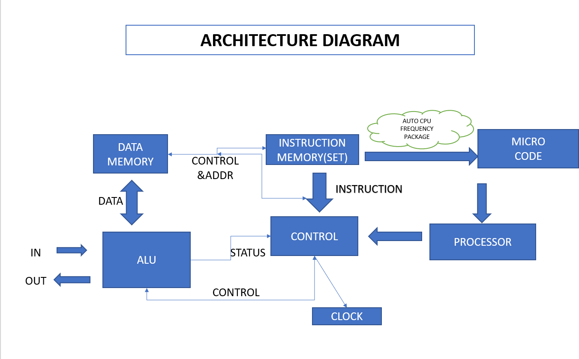
SYSTEM ARCHITECTURE DIAGRAM

Slide 7
LIST OF MODULES
Intel_pstate-This driver implements a scaling driver with an internal governor for Intel Core (Sandy Bridge and newer) processors.
Amd-pstateThis driver implements a scaling driver with an internal governor for AMD Ryzen (some Zen 2 and newer) processors.
Intel_cpufreqStarting with kernel 5.7, the intel_pstate scaling driver selects "passive mode" aka intel_cpufreq for CPUs that do not support hardware-managed P-states (HWP), i.e. Intel Core i 5th generation or older.
Acpi-cpufreqCPUFreq driver which utilizes the ACPI Processor Performance States. This driver also supports the Intel Enhanced SpeedStep (previously supported by the deprecated speedstep-centrino module).
speedstep-libCPUFreq driver for Intel SpeedStep-enabled processors (mostly Atoms and older Pentiums)
Powernow-k8CPUFreq driver for K8/K10 Athlon 64/Opteron/Phenom processors. Since Linux 3.7 'acpi-cpufreq' will automatically be used for more modern AMD CPUs.
Pcc-cpufreqThis driver supports Processor Clocking Control interface by Hewlett-Packard and Microsoft Corporation which is useful on some ProLiant servers.
P4-clockmodCPUFreq driver for Intel Pentium 4/Xeon/Celeron processors which lowers the CPU temperature by skipping clocks. (You probably want to use a SpeedStep driver instead.)

Slide 8
MODULES DESCRIPTION
Optimize CPU Speed And Power With Auto-cpufreq In Linux
The output will keep updating every 5 seconds. Nothing will be changed in your system. It is just a visual demonstration to show you what auto-cpufreq could do differently for your system. To abort this monitoring, simply press CTRL+c.
This mode is for evaluation purpose. All necessary changes are temporarily applied to your system. In this mode, you will display how your system would behave after permanently enabling auto-cpufreq. Please note that these changes will be lost on system reboot.
$ sudo python3 auto-cpufreq.py
When running auto-cpufreq without any options, you will see the help section that
shows you the example usage and list of available options and modes.
This mode is for evaluation purpose. All necessary changes are temporarily applied to your system. In this mode, you will display how your system would behave after permanently enabling auto-cpufreq. Please note that these changes will be lost on system reboot.

Slide 9
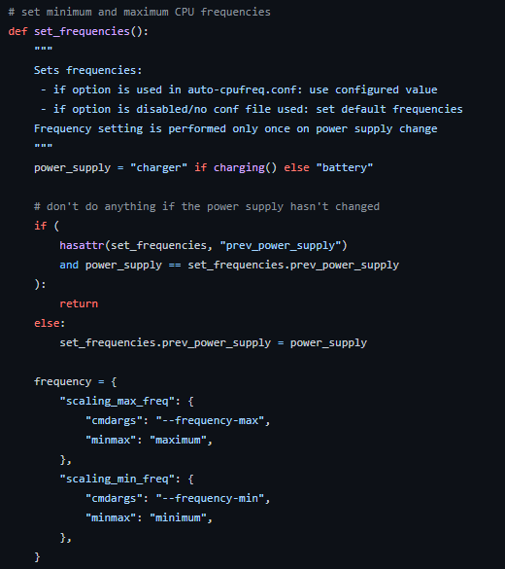
MODULES TILL COMPLETED .py

Slide 10

TECH OVERVIEW AND INTERFACE OVERVIEW
Tech Overview
Shell Scripting
A shell script is a computer program designed to be run by the Unix shell, a command- line interpreter. The various dialects of shell scripts are considered to be scripting languages.
Python Libraires
A Python library is a collection of related modules.
It contains bundles of code that can be used repeatedly in different programs. It makes Python Programming simpler and convenient for the programmer.
Open Source Open-source software (OSS)
It is computer software that is released under a license in which the copyright holder grants users the rights to use, study, change, and distribute the software and its source code to anyone and for any purpose.

Slide 11
FEATURE OVERVIEW
The performance of your cpu-the “brain”of your pc -has a major impact on the spped at which programs load how smoothly they run.
However, there are a few different ways to measure processor performance
Dynamic power & frequency controlling for the processor to achieve efficiency with low heat production .
Automatic Frequency Control (AFC), also called Automatic Fine Tuning (AFT), is a method or circuit to automatically keep a resonant circuit tuned to the frequency of an incoming radio signal.
It is primarily used in radio receivers to keep the receiver tuned to the frequency of the desired station.

Slide 12
CONCLUSION
In this paper we propose a statistical approach to estimate the CPU frequency transition latency. We also implemented a tool called FTaLaT able to automatically measure the frequency transition latency for each pair of distinct CPU frequencies. FTaLaT relies on confidence intervals to determine when a given target frequency is effectively enforced. We showed on our experimental setup that, when a target frequency is higher than a start frequency, transition latency increases linearly. On the other hand, when target target frequencies are lower than start frequencies, transition latencies are smaller and tend to be constant. Moreover, we observe that the range between the minimal and maximal transition latency decreases with newest processor generations, reflecting technology enhancement over time.

Slide 13

THANK YOU

